Slide 1

WWW.ChinaNet.CC CHINANET TECHNOLOGY (SUZHOU) CO., LTD
Cloud computing data center and Internet + service provider

Slide 2
What are we doing? Business model, product model
  Chinanet technology makes it easy to use water and electricity, and pay by usage.
  Users can have more energy to invest in their professional fields.
  Solve the complexity and timeliness of user information process. Reduce cost and enhance competitiveness for users.
  The data centers of Chinanet technology are available throughout the province, offering products and services:
  ★ Cloud computing services: cloud server, public cloud, private cloud, hybrid cloud.
  ★ IDC data center: server hosting, server rental, machine room customization. Super computing center.
  ★ Website service: domain name registration, website hosting, website construction, website promotion.
  ★ Value-added services: network solutions, network security, service outsourcing.

Slide 3
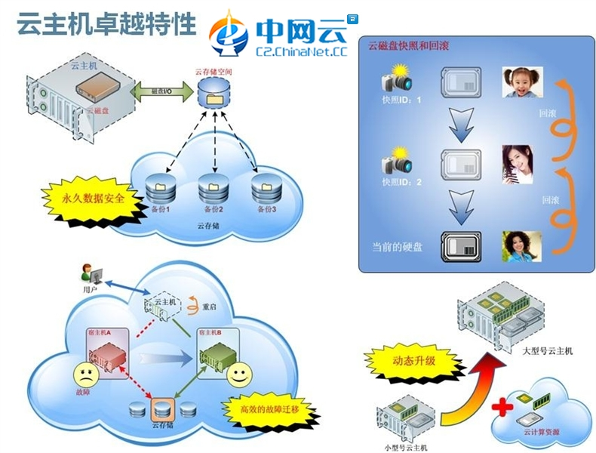
What are we doing? 1. Cloud computing services
★ Cloud computing services:
Cloud server, public cloud, private cloud, hybrid cloud
Cloud computing is a pay-as-you-go model. It is the upgrade mode of IDC data center.
The ChinanetCloud allows users to access the CPU, memory, space, network, software, technology, data and other resources as easily as using water and electricity.
※ Reduce cost, pay on demand, open immediately, rapid
deployment
※ Elastic expansion, upgrade at any time, disaster recovery,
safe and reliable
※ Self-backup, data reduction, performance monitoring, graphic
display
※ Self-management, remote switching machine, restart
reloading operating system

Slide 4
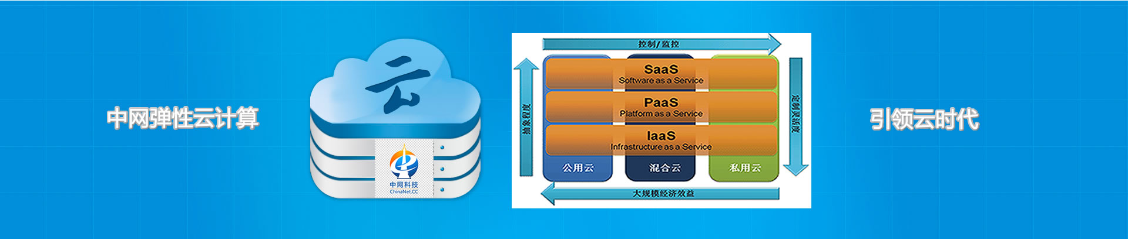
What are we doing? 1. Cloud computing services
Public cloud - elastic computing cloud server infrastructure (1 nuclear 1G10G1M1 snapshot 1 backup)
Pay as required and increase the allocation price (yuan/month) to see the following table:
Node | CPU / core | Memory / G | Hard disk / 10G | Bandwidth / M | IP/a | The snapshot/a | Backup/a
Anhui double Jiangsu high anti US BGP | 30 | 20 | 3 | 20 | 50 | 10 | 20
Beijing BGP Hong Kong BGP | 30 | 20 | 3 | 70 | 50 | 10 | 20
Private cloud, hybrid cloud - medium - network technology can be customized for users.

Slide 5


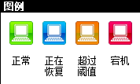
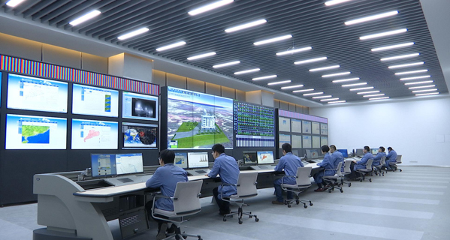
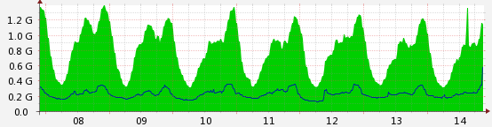
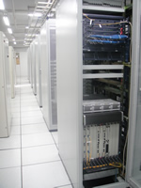

What are we doing? 2. IDC data center
★ IDC data center
Server hosting, server rental, machine room customization, network bandwidth
Provide specialized business support and services for Internet content providers (ICP), enterprises, media, government and various websites.
Electricity: dual electricity, uninterrupted UPS, diesel fire
The internet : high redundancy, multi-line BGP, multi-operator
SLA: network and power connectivity are 99.99%
Standard: international T3 + ~ T4 +, China A,
constant temperature and humidity,
8 + seismic, up to 16KN/㎡ bearing, the height 5.5 meters,
Advanced security, gas fire, first-line brand equipment,
Higher ground, better flood control ability,
PUE1.05 (Inner Mongolia) ~ 1.5 (Anhui)
365 * 24 hours of operation.

Slide 6
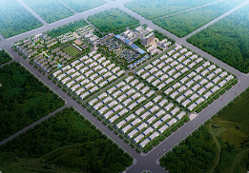
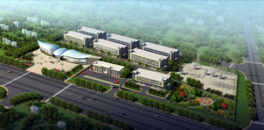
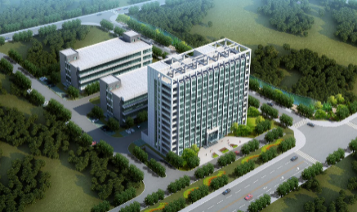
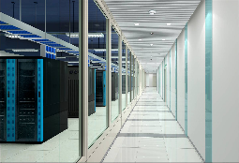
What are we doing? 2. IDC data center
★ Chinanet technology (Inner Mongolia) cloud computing base:
Location: 9km east of hailar airport
Area: 1 square km (1500 mu)
Size: 10000 ㎡ x 100 x 1536 x 20 cabinet
Standard: international T3 + ~ T4, national standard A,
can also be customized
Cost: PUE is lower than 1.1 and the price is low to 0.15 yuan
Power: the national power grid 110KV substation is
built on the base plot
Network: telecom, unicom, mobile double routing pipeline
loop access
Status: 1 data center building has been completed!
Municipal government cloud computing center, public security data center
Supercomputing and cloud rendering center, waiting to enter.
★ Chinanet technology (Anhui) cloud computing base:
Location: 14KM west of nanjing
Land area: 50 mu
Size: 10000 ㎡ x 3 x 1680 x 20 cabinet
Standard: international T3 + ~ T4, national standard A, can also be customized
Cost: PUE below 1.5, large industrial electricity price
Power: the national power grid 110KV substation is 500 meters from the base
Network: telecom, unicom, mobile double routing pipeline loop access
Status: The first data center is completed and completed
ICP users have about 1,000 servers waiting to be deployed
The customer wants 20,000 waiting to enter.

Slide 7

What are we doing? 2. IDC data center
We have purchased several brands and models of servers for users to rent. Other requirements can be customized.
We have built multiple data centers, disaster recovery centers; T4 and class A data center standards:
IDC room | 1U / station | 2U / station | 4U / station | Cabinet / unit | Customized room
Main: jiangsu, anhui, Inner Mongolia, Beijing, Hong Kong, USA Cooperation: up to 200 IDC machines in the provinces | 1,990 yuan \year | 2,388 yuan \year | 2,990 yuan \year | 29,990 yuan \year | confer
Single server hosting includes free electricity, 10M bandwidth, 1 IP, remote pre-connection service. Other requirements can be customized. The whole cabinet includes free electricity 10A, 100M bandwidth, 16 IP, and pre-service. Other requirements can be customized. The cloud rendering machine room, the supercomputing machine room, and other types of machine room - the center network technology can be customized for users.

Slide 8
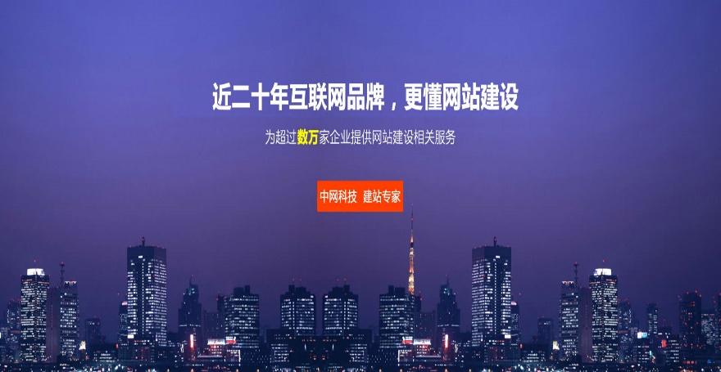

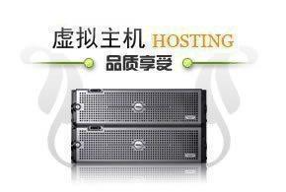

What are we doing? 3. Website service
★ Website service:
Domain name registration, website hosting, construction promotion
※ ICANN's top certification and security;
※ Autonomous management, independent
control, intelligent resolution;
※ WHOIS privacy protection, free roll-in/transfer/transfer
※ High-end server, superior performance
※ Operation of 7 x 24H operation dimension
in more than 10 years
※ Multi-machine room multi-line high cost performance
※ Free filing, trial, maintenance
※ Automatic backup and security

Slide 9

What are we doing? 4. Value-added services
★ Value-added services:
Let information technology have no threshold!
Various industry network solutions, network security, service outsourcing
※ Information application and data center customization and solutions of various industries;
※ Private cloud customization/deployment/hosting, can connect public cloud, realize hybrid cloud;
※ System security, web security, FTP application security, database application and other management;
※ Server operation control, file cleaning, failure, hacker attack emergency treatment.

Slide 10
What conditions do we have?
Professional brand: ChinaNet.CC international domain name trademark high value.
Focus industry: founded in 2002, we have focused on cloud computing data center for over ten years.
International certification: the top international business certification of ICANN, only a few dozen in China.
Fully qualified: owning telecom operation license B1 (IDC) + B2 (ISP + ICP).
Product advantage: there are many cloud computing data centers, the production and supply of a dragon.
Resource advantage: an international APNIC alliance member, with its own IP address and domain.
Marketing advantages: automatic growth mode of e-commerce pipeline; Tens of thousands of members.
Technical advantages: more than 20 software Copyrights have been awarded in the last three years,
leading the technology industry.
建议内容：
可以用文字或者图示
扼要的说明公司具备明显优势（如品牌、技术、产能、市场渠道等）,目的是想别人听了想继续听下去

Slide 11
Our unique competitive advantage?
Technology: more than 500,000 technical services are provided to global users.
Research and development: 21 pieces of software (cloud computing virtualization, software definition network,etc.)
Intelligence: the platform system is highly intelligent, and the automation "pipeline" brings users a better experience.
Cost: the direct power supply of the power plant is low to 0.15 yuan/KWH, saving 70%.
Unique: occupation which 48 ° north latitude, natural cold source energy saving 95%.
Foreign aid: the government has invested tens of millions of yuan in supporting the Chinese Internet technology project
and provided business support.

Slide 12
Our unique competitive advantage?
Industry: well-known cloud computing, big data, Internet + high - rate growth industry characteristics.
Labor: talent self-cultivation, reasonable wages, and low regional cost, no regional requirements.
Foundation: after nearly five years of advanced placement, it compacted the basic supporting body.
Customer: own customer, cultivate the user experience habit, the degree of stability is high.
Market: the global market now has nearly 30,000 small and medium users. The growth of the incubation users also contributed to the development of the technology.
In the first quarter of 2016, two customer business grew to > million yuan per year (the previous years < 5000 yuan/year)
Chinanet technology has many years old customers with > million yuan/year business development and development capability.
Over the next three years, users of the * * cloud app, which has been incubating for nearly a decade, could bring in a $1 billion business.

Slide 13
Our marketing?
Marketing methods:
Internet online e-commerce marketing. Online promotion, promotion, industry information.
Small user online negotiation, middle - large user - offline visits.
Channel distribution, office, agent, founder.
Marketing system support:
Platform support system (WEB Shop、 Web Service 、WEB ERP、WEB CMS, etc.), customers can be registered in Chinanet technology’s website (WWW.ChinaNet.CC), choose products online, online payment, and obtain the information required for the hardware (servers), software, broadband, IP address, and other supporting products, including cloud computing products (cloud server) only need 3 ~ 5 minutes minutes and installed a variety of operating systems can be obtained.

Slide 14


































Our customers?
Chinanet technology has tens of thousands of customers...

Slide 15
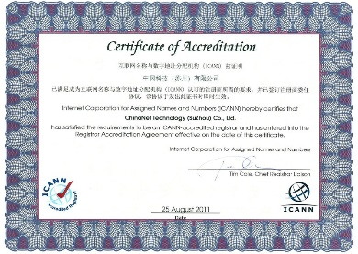
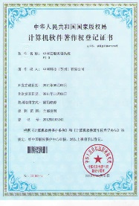






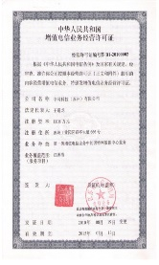
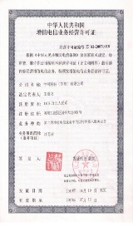
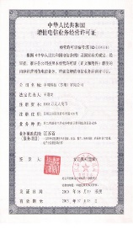
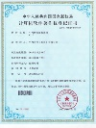
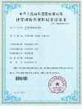
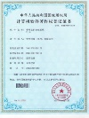



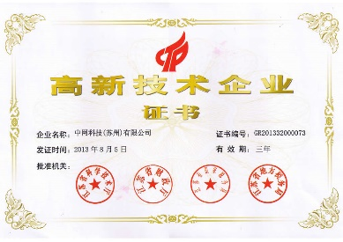
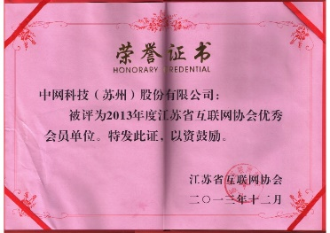
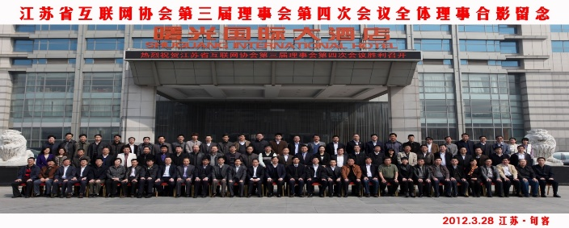
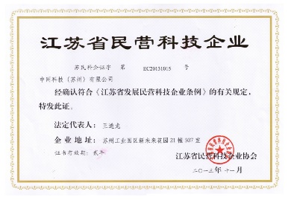
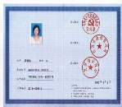
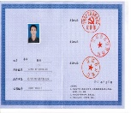
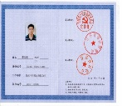
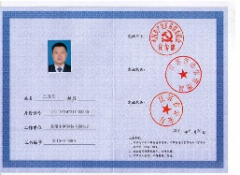
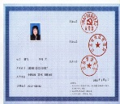
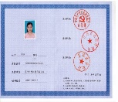
What Qualification certificate do we have?
Business license, certificate of qualification, honorary certificate, software copyright and patent...

Slide 16
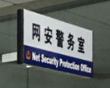
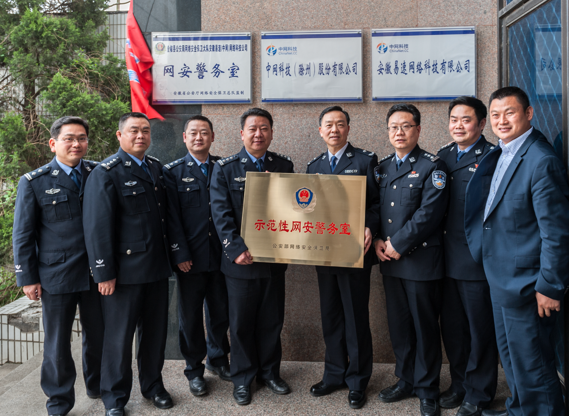
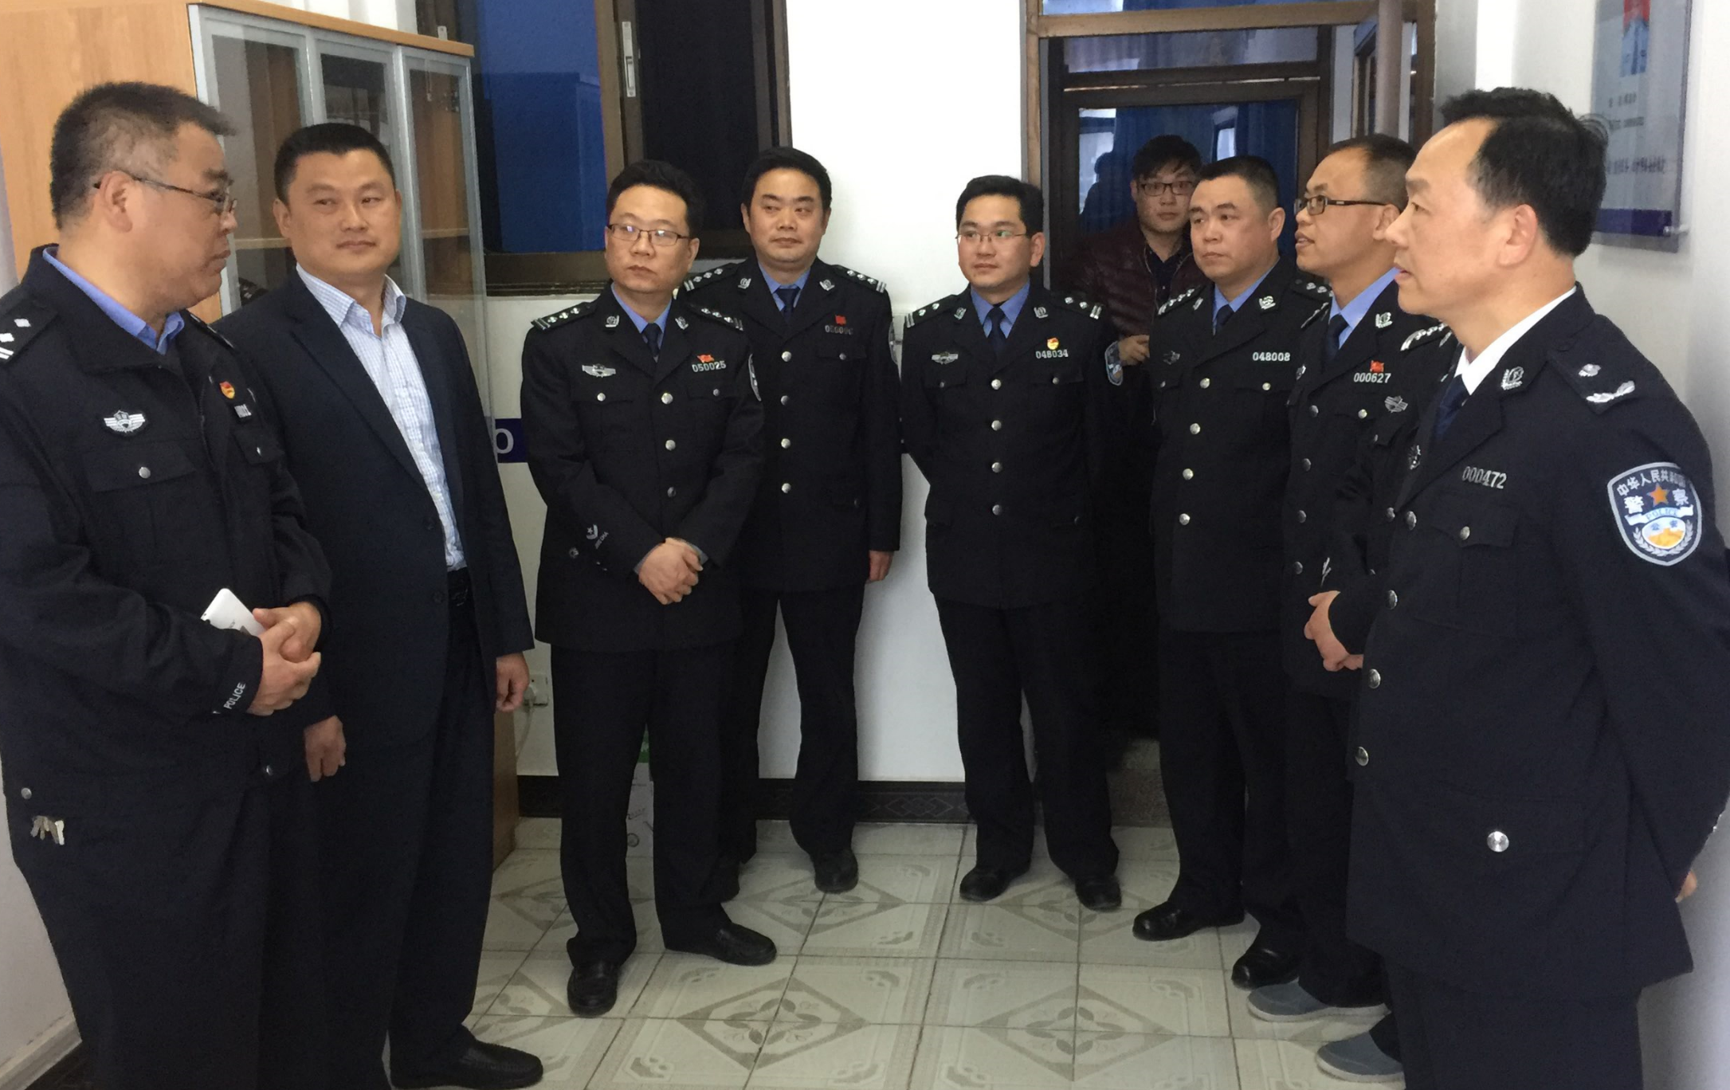
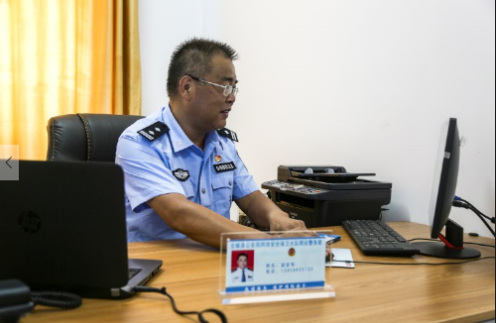
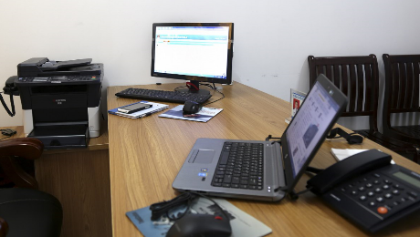
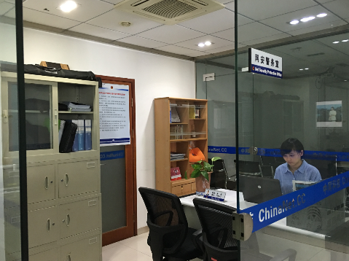
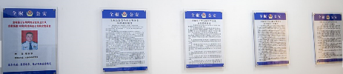
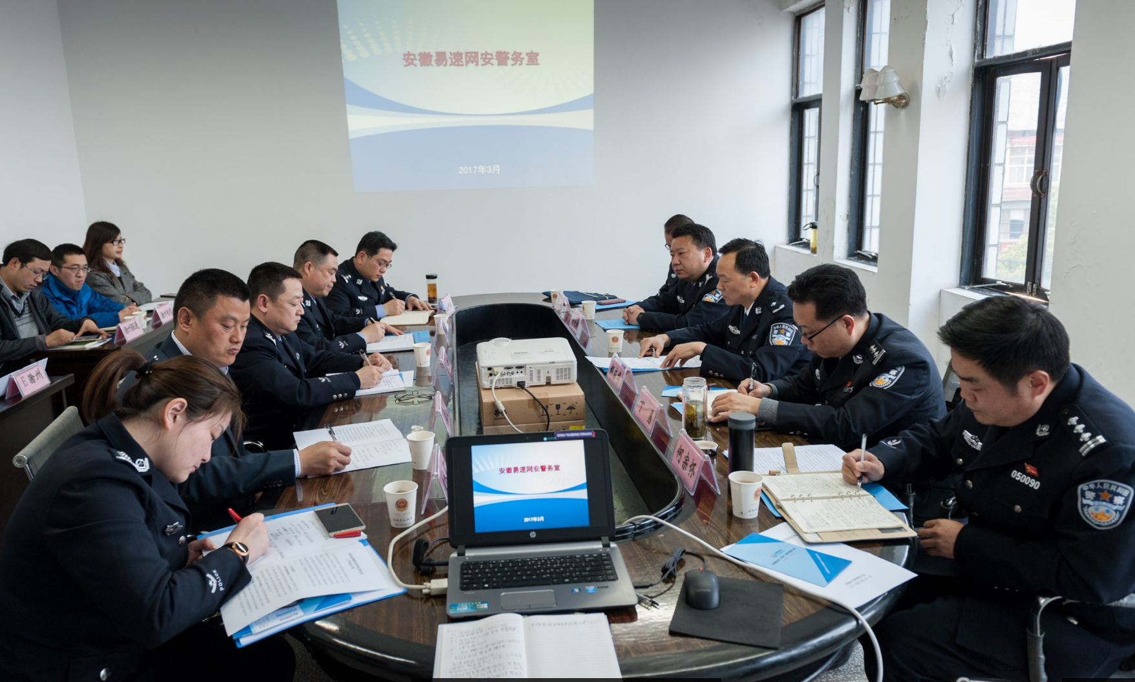
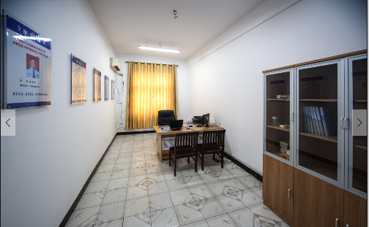
We regulate the legal, security network security
The company set up the Ministry of Public Security National Security Network Security Center
Social responsibility, network security, corporate governance norms

Slide 17
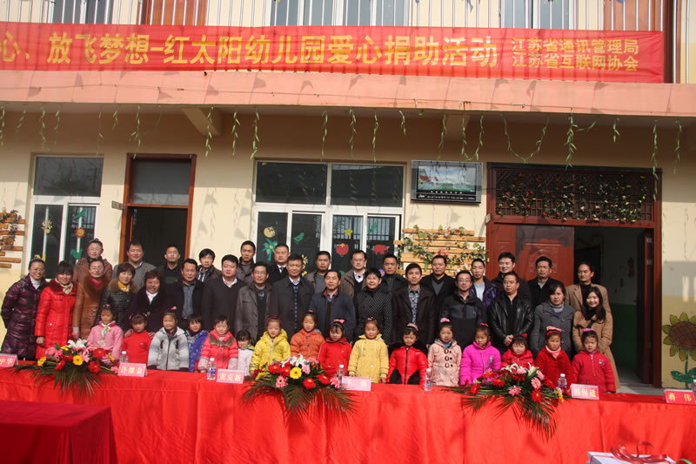
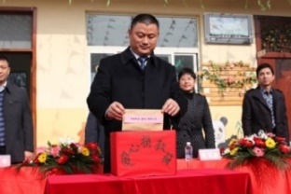
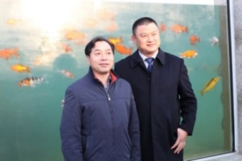
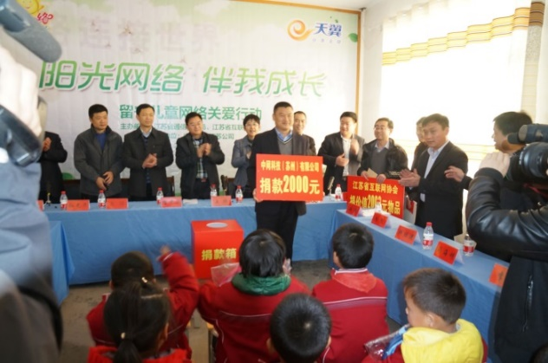
We participate in the social welfare
"Care for love, dream of flying" and care for left-behind children

Slide 18
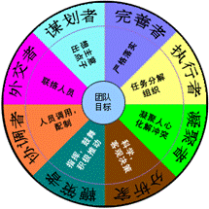
The configuration of our team
The main members of the team are members of the Chinese network, with 5-10 years of management experience.
Configures the roles of eight groups: planners, diplomats, coordinators, spurters, analysts, cohesors, performers, and perfectionists.
Create a three-dimensional management mode, so that there is no conflict of interest among the team.

Slide 19
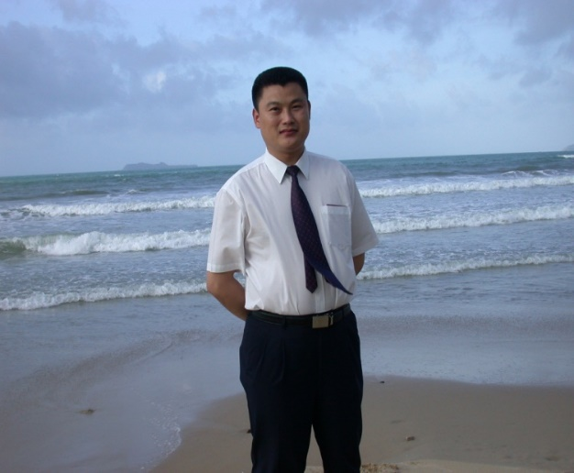
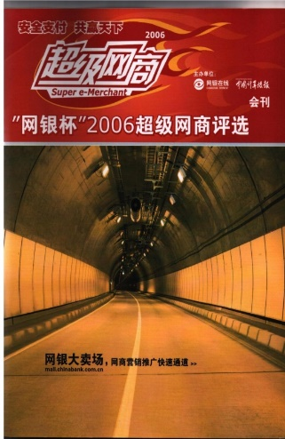
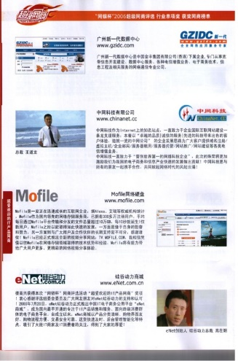
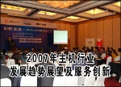
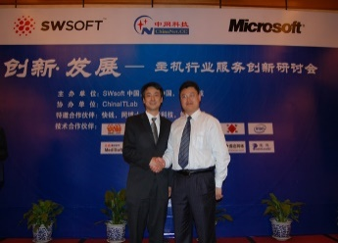
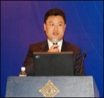









Founder of Chinanet technology
★ Dao-long Wang
Chinanet technology - chairman, general manager
New technology of Internet technology in Jiangsu province
Director of China - UK Cloud Computing Virtual Engineering Center - University of Liverpool
Executive director of Jiangsu Internet association
Member of China's democratic
establishment
Several university visiting
professors
Cloud computing expert consultant
Enterprise management for 20 years

Slide 20
The future of the company
Industry outlook:
Cloud computing data center is an important guarantee for Internet + base support and industrial transformation and upgrading.
Market trend:
With the continuous promotion of "made in China 2025" and "Internet +", various industries urgently need to promote the transformation and upgrading of industry through the cloud computing system. At the same time, the development of cloud computing industry is maturing, and successful cases are emerging, which also makes the user's cognition and adoption of cloud computing constantly improve.
During the 12th five-year plan period, China's cloud computing industry grew at an average annual rate of more than 30 percent and reached about 150 billion yuan in 2015, the ministry of industry and information technology said. The total size is expected to reach 800 billion yuan by 2018.
Company outlook:
It is estimated that by 2020, annual sales will exceed 1 billion yuan, with a net profit of 100 million yuan and the stock market value of 10 billion yuan.

Slide 21
THANKS
Thank you for your support!
CHINANET TECHNOLOGY (SUZHOU) CO., LTD
URL: Http://ChinaNet.CC
Phone: 0512-8886-8888
Fax: 0512-8886-8899
Service QQ: 800001180
Address: 5 / f, international center, 535 west shenhu road, suzhou park
Postcode：215028

